Slide 1
Deep Learning
Natural Language Processing applications

Slide 2
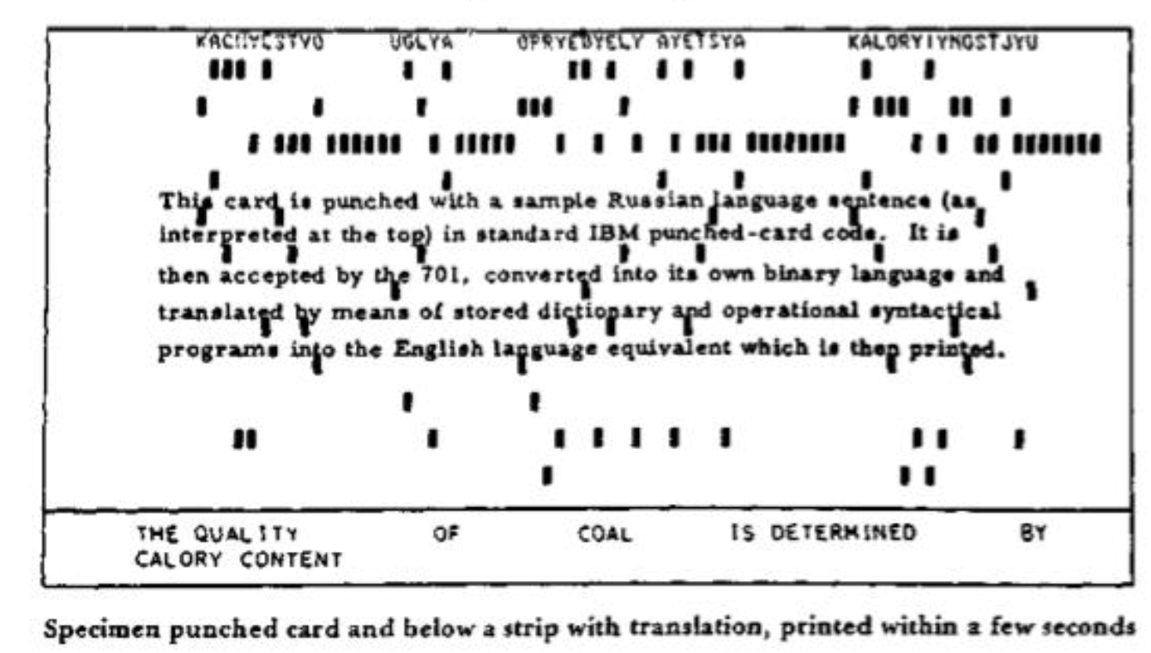
Georgetown-IBM experiment 1954
goal: translate 60 Russian sentences into English
rule-based approach
‘Machine Translation will be solved in 5 years’

Slide 3
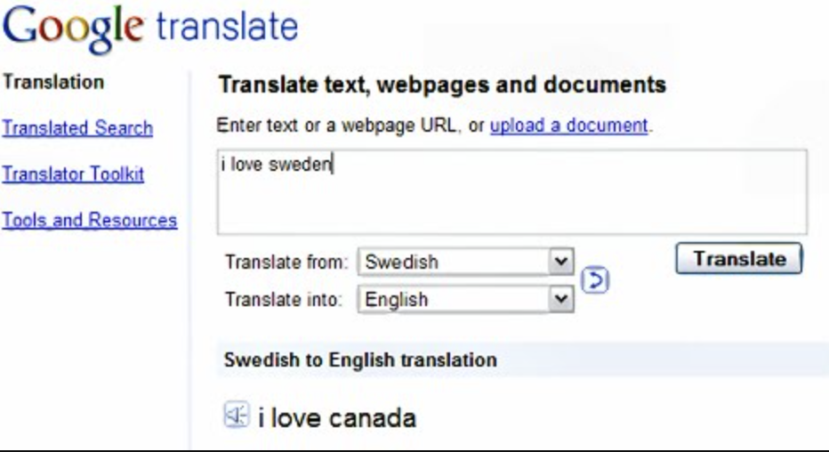
Statistical Machine Translation
before 2016: Google Translate powered by phrase based approaches

Slide 4
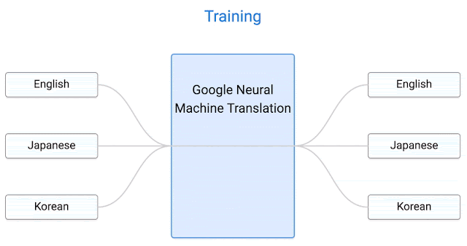
Neural Machine Translation
before 2016: Google Translate powered by phrase based approaches
after 2016: single end-to-end Neural Network (Wu et al. 2016) translates between all language pairs
source: https://research.google/blog/zero-shot-translation-with-googles-multilingual-neural-machine-translation-system/

Slide 5
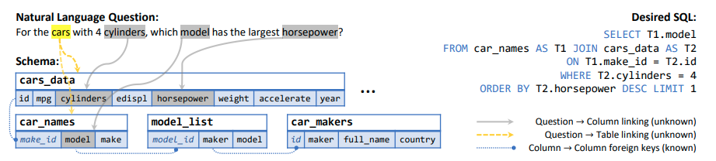
text-to-SQL generation (Wang et al. 2020)
given a user’s request and a database schema, generate the appropriate SQL
figure from Wang et al. 2020

Slide 6
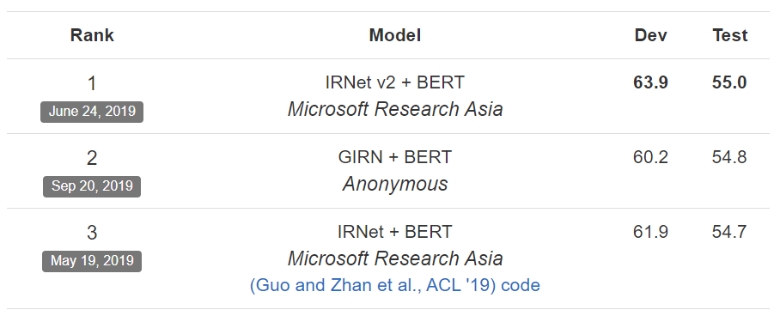
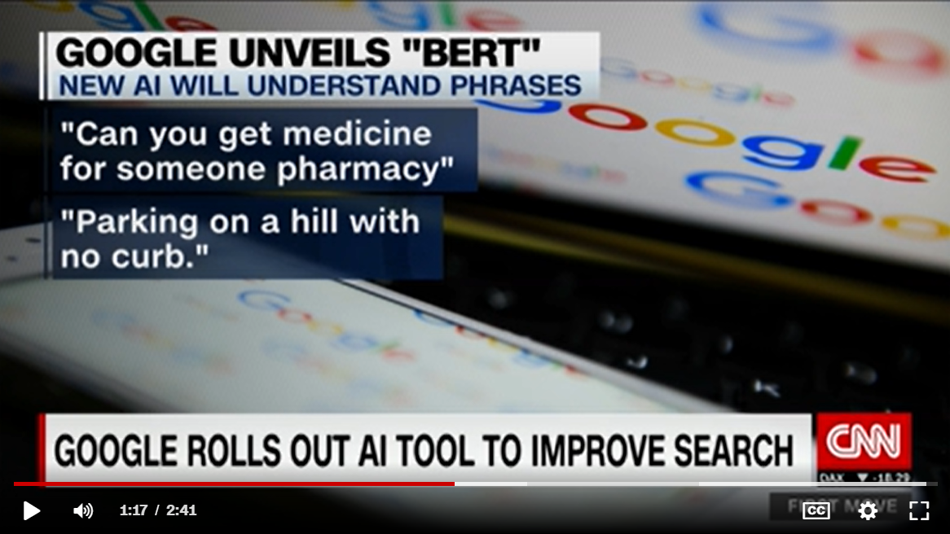
BERT (Google 2018)
BERT features useful for transfer learning => SOTA results on many NLP tasks
industry adoption (powering Google Search)

Slide 7
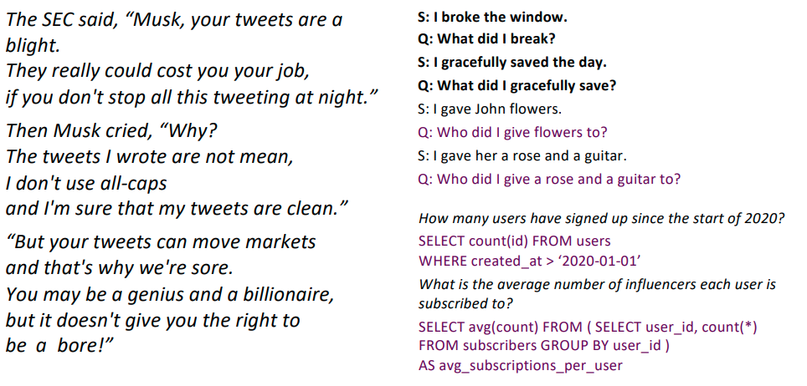
OpenAI GPT-3 (Brown et al. 2020)
first large language model: 175B parameters
generates human-like poetry, code, dialogue
solves NLP tasks in zero/few-shot way

Slide 8
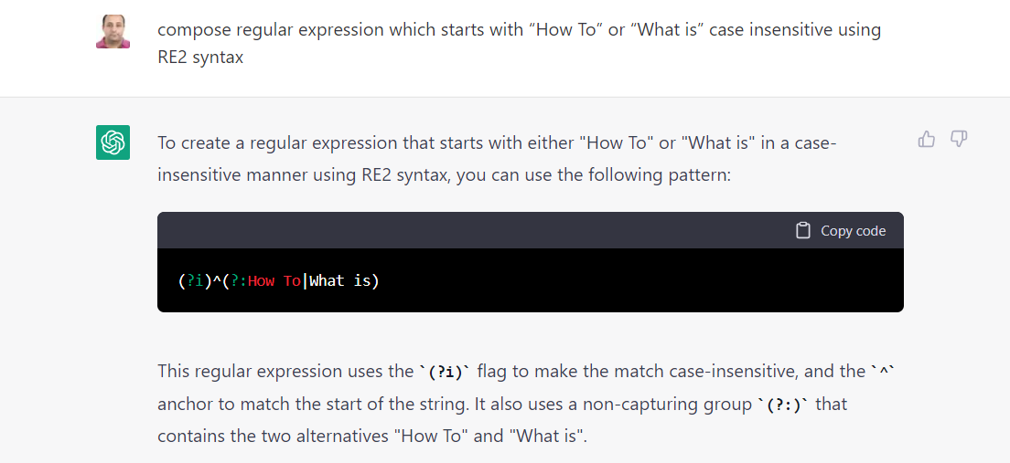
chatGPT (OpenAI 2022)
chatbot based on GPT3.5
solves NLP tasks or novel requests in zero/few-shot way
aligned to generate human-like responses
source https://www.searchenginejournal.com/chatgpt-examples/474937/

Slide 9
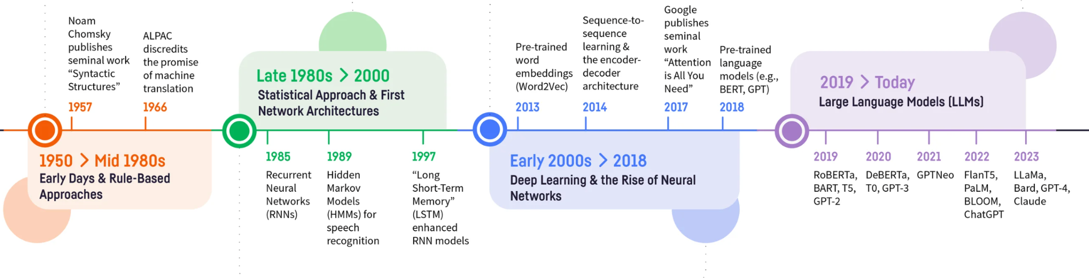
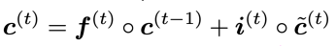
NLP timeline
source: https://blog.dataiku.com/nlp-metamorphosis

Slide 10
Recap

Slide 11
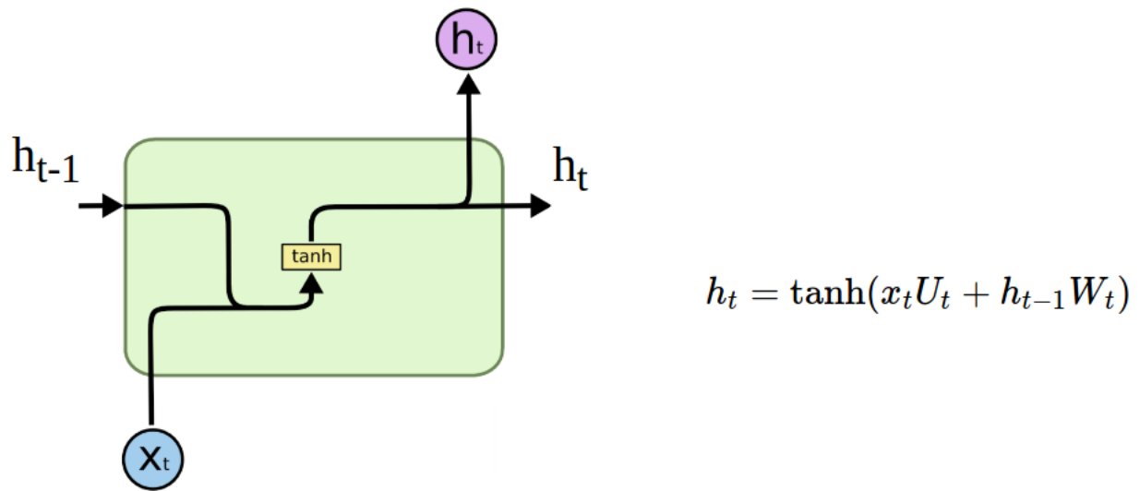
Recurrent neural network (RNN)
history-aware NN for sequential data
API: new_memory = f(current_input, old_memory)
Vanilla RNN cell. Snapshot from http://colah.github.io/posts/2015-08-Understanding-LSTMs/

Slide 12
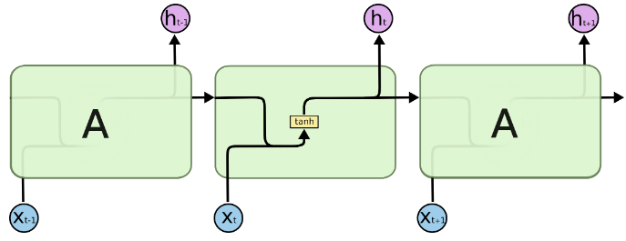
Unrolling vanilla RNN
apply same computation at each timestep
we get a new memory/hidden state at each timestep
how is information from x_{t+1} connected to x_{t-1}?
Unrolled vanilla RNN cell. Snapshot from http://colah.github.io/posts/2015-08-Understanding-LSTMs/

Slide 13
Unrolling vanilla RNN
apply same computation at each timestep
we get a new memory/hidden state at each timestep
how is information from x_{t+1} connected to x_{t-1}?
through hidden state h_{t}
Unrolled vanilla RNN cell. Snapshot from http://colah.github.io/posts/2015-08-Understanding-LSTMs/

Slide 14
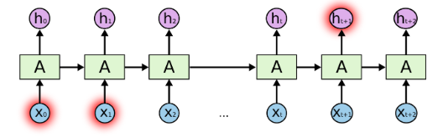
Vanilla RNN for long-term dependencies
in theory, vanilla RNN can learn long-term dependencies
in practice, vanishing gradients prevent RNN from preserving information over many timesteps
Unrolled vanilla RNN cell. Snapshot from http://colah.github.io/posts/2015-08-Understanding-LSTMs/

Slide 15
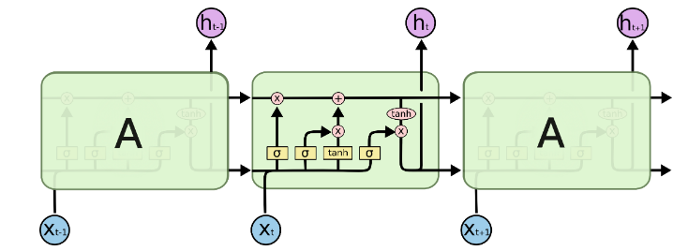
LSTM for long-term dependencies
gates block information or let it flow
they control the importance of current info and past memory
they help with learning long-term dependencies (but these can still be tricky to learn)
c_{t-1}
c_{t}
f_{t}
i_{t}
Unrolled vanilla RNN cell. Snapshot from http://colah.github.io/posts/2015-08-Understanding-LSTMs/

Slide 16
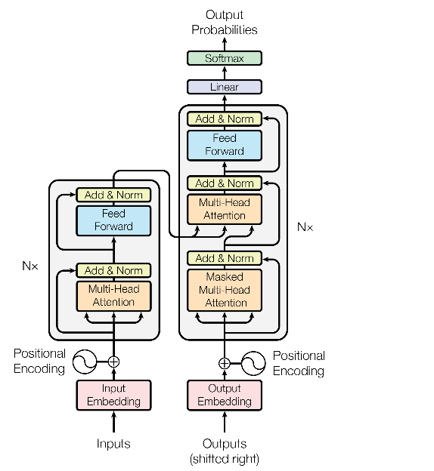
Transformer block - recap
recurrent-free, parallelizable alternative for sequence processing
constant gradient path (every element directly interacts with all the other elements)
building block for SOTA architectures in NLP (BERT, GPT-2) and foundational models

Slide 17
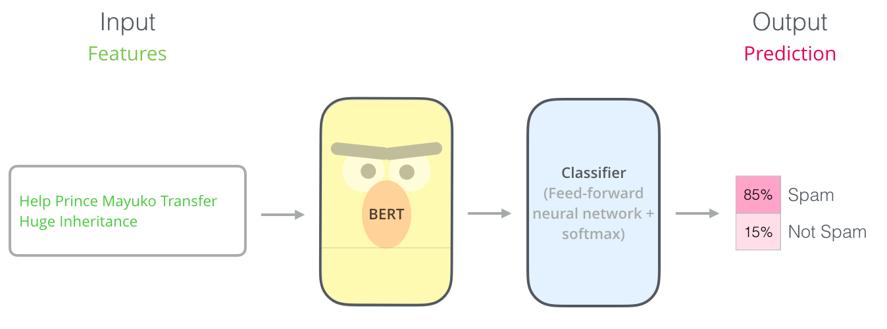
Spam classification
source: https://jalammar.github.io/illustrated-bert/

Slide 18
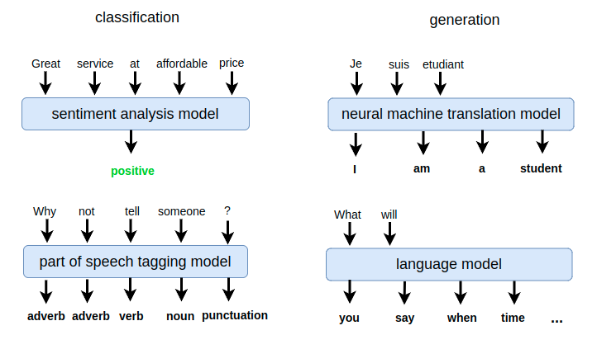
NLP application types
classification tasks:
many-to-one (text-level classification)
many-to-many (token-level classification)
generation tasks:
many-to-many (neural machine translation, text summarization, language modeling etc.)

Slide 19
Part 0: Setting things up

Slide 20
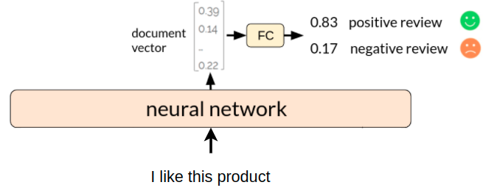
NN for text classification

Slide 21
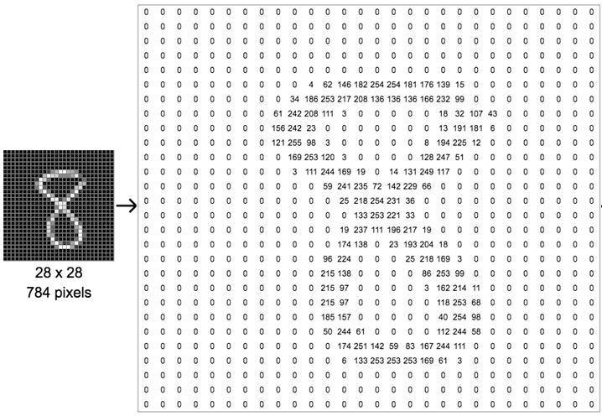
Numerical representation
we know how to represent an image with numbers

Slide 22
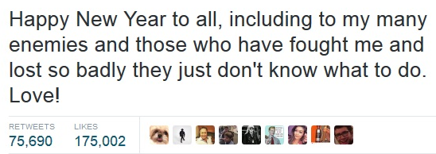

Numerical representation
we know how to represent an image with numbers
but how do we represent a text with numbers?

Slide 23
First, how do we split text?
split into characters
‘H’, ‘a’, ‘p’, ‘p’, ‘y’, ‘ ‘, ‘N’, ‘e’, ‘w’, ‘ ‘, ‘Y’, .... , ‘L’, ‘o’, ‘v’, ‘e’, ‘!’

Slide 24
First, how do we split text?
split into characters
‘H’, ‘a’, ‘p’, ‘p’, ‘y’, ‘ ‘, ‘N’, ‘e’, ‘w’, ‘ ‘, ‘Y’, .... , ‘L’, ‘o’, ‘v’, ‘e’, ‘!’
split into words
‘Happy’, ‘New’, ‘Year’, ‘to’, ‘all’, ‘,’, ‘including’, ..., ‘Love’, ‘!’

Slide 25
First, how do we split text?
split into characters
‘H’, ‘a’, ‘p’, ‘p’, ‘y’, ‘ ‘, ‘N’, ‘e’, ‘w’, ‘ ‘, ‘Y’, .... , ‘L’, ‘o’, ‘v’, ‘e’, ‘!’
split into words
‘Happy’, ‘New’, ‘Year’, ‘to’, ‘all’, ‘,’, ‘including’, ..., ‘Love’, ‘!’
split into wordpieces
‘Happy’, ‘New’, ‘Year’, ‘to’, ‘all’, ‘,’, ‘includ’, ‘##ing’, ..., ‘Love’, ‘!’

Slide 26

Tokenization
process by which we split text into smaller units, called tokens
the set of all unique tokens is called the vocabulary
hello, my, name, is, Anne, and, I, write, …
unibuc, ro, cercetare, domenii, de, cercetare, ?, lang, =, en

Slide 27
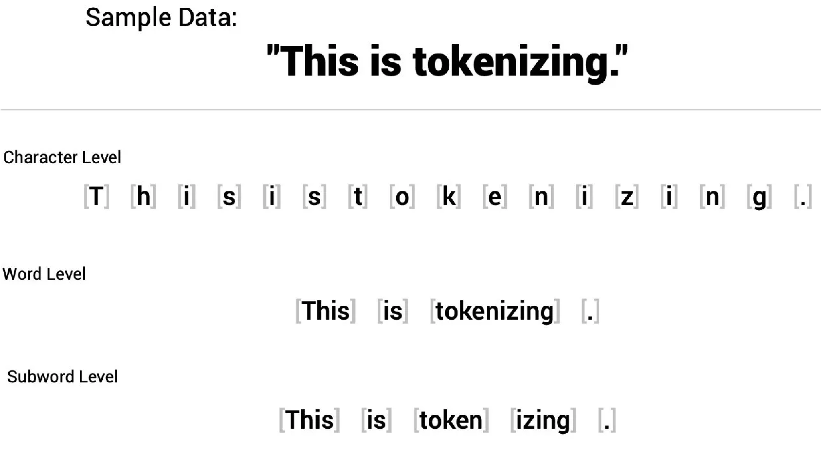
Tokenization levels
source: https://medium.com/@abdallahashraf90x/tokenization-in-nlp-all-you-need-to-know-45c00cfa2df7

Slide 28
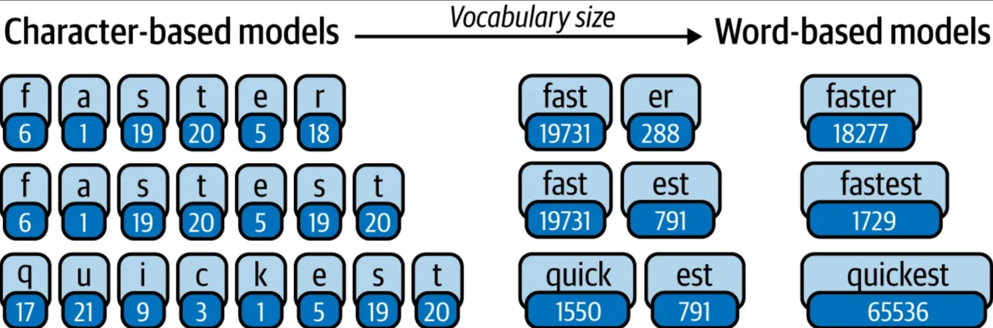
Tokenization levels
source: https://medium.com/@abdallahashraf90x/tokenization-in-nlp-all-you-need-to-know-45c00cfa2df7

Slide 29
Tokenization levels
source: https://medium.com/@abdallahashraf90x/tokenization-in-nlp-all-you-need-to-know-45c00cfa2df7

Slide 30
Tokenization levels
character level:
small vocabulary
linguistic units have to be learned as well
source: https://medium.com/@abdallahashraf90x/tokenization-in-nlp-all-you-need-to-know-45c00cfa2df7

Slide 31
Tokenization levels
character level:
small vocabulary
linguistic units have to be learned as well
word level:
large vocab becomes computationally expensive
cannot deal with unknown words or misspelt words
source: https://medium.com/@abdallahashraf90x/tokenization-in-nlp-all-you-need-to-know-45c00cfa2df7

Slide 32
Tokenization levels
character level:
small vocabulary
linguistic units have to be learned as well
word level:
large vocab becomes computationally expensive
cannot deal with unknown words or misspelt words
subword level:
smaller vocab size than word level
unknown words can be split into known parts: adorkable = [a], [dork], [able]
source: https://medium.com/@abdallahashraf90x/tokenization-in-nlp-all-you-need-to-know-45c00cfa2df7

Slide 33
Say we split text into words, how do we encode them?
tokenize text
‘Happy’, ‘New’, ‘Year’, ‘to’, ‘all’, ‘,’, ‘including’, ..., ‘Love’, ‘!’
encode
words
‘Happy’ = ?
‘New’ = ?
…
‘!’ = ?

Slide 34
Part 1: Words are vectors
apple
bat
…
zebra

Slide 35
One-hot representation for words
…
car = [0 0 0 0 0 1 0 0 0 0 0 0 0 0 0 0 0 0 0 0 0 … ]
vocabulary …
bus = [0 0 0 0 0 0 0 0 0 0 0 0 0 0 1 0 0 0 0 0 0 … ]
....
simplest representation (makes no assumptions)
vectors are orthogonal (don’t capture similarity)
size = number of words in vocabulary

Slide 36
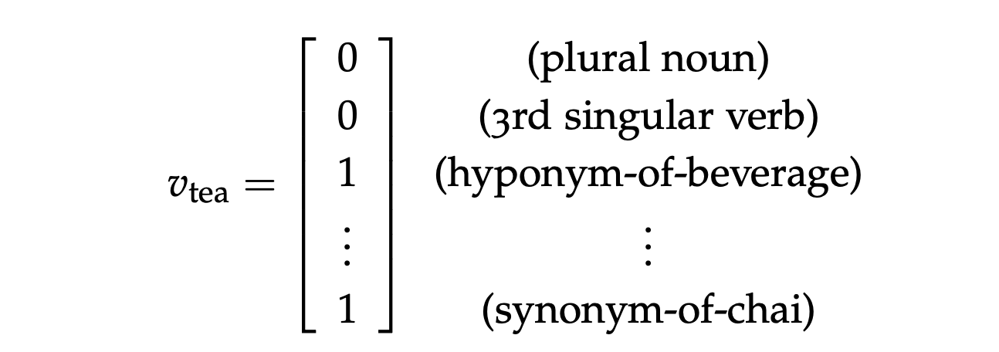
Handcrafted feature vectors
features from dictionaries and databases such as WordNet
linguistically informed
high-dimensional, sparse representations => larger layers to process them
depends on external human-annotated sources to be up-to-date

Slide 37
Dense representation for words (embeddings)
…
car = [0.12 0.17 0.93 … 0.10 0.98]
vocabulary …
bus = [0.64 0.07 0.86 … 0.23 0.56]
....
each word is represented by a dense feature vector
these vectors are not handcrafted, but learned by a network
size ∈ [50, 1000]

Slide 38
Dense representation for words
‘vehicleness’
…
car = [0.12 0.17 0.93 … 0.10 0.98]
vocabulary cat = [0.41 0.15 0.17 … 0.81 0.20]
bus = [0.64 0.07 0.86 … 0.23 0.56]
....
dimensions could encode different properties (not always interpretable)
size ∈ [50, 1000]

Slide 39
Dense representation for words
‘vehicleness’
‘animal’
…
car = [0.12 0.17 0.93 … 0.10 0.98]
vocabulary cat = [0.41 0.15 0.17 … 0.81 0.20]
bus = [0.64 0.07 0.86 … 0.23 0.56]
....
dimensions could encode different properties (not always interpretable)
size ∈ [50, 1000]

Slide 40
Dense representation for words
‘vehicleness’
‘animal’
…
car = [0.12 0.17 0.93 … 0.10 0.98]
vocabulary cat = [0.41 0.15 0.17 … 0.81 0.20]
bus = [0.64 0.07 0.86 … 0.23 0.56]
....
dimensions could encode different properties (not always interpretable)
similar words (‘car’, ‘bus’) will tend to have similar features
size ∈ [50, 1000]

Slide 41
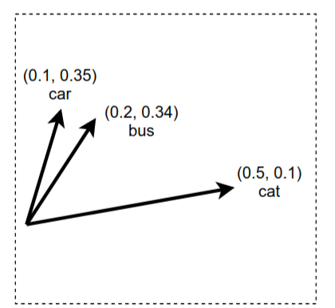
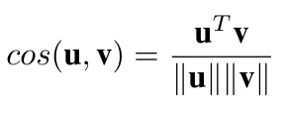
Measure words similarity
Using their word vectors :
dot product: u^{T}v
cosine similarity:
similarity(car, bus) = (0.1 * 0.2 + 0.35 * 0.34) / 0.145 = 0.95
similarity(car, cat) = (0.1 * 0.5 + 0.35 * 0.1) / 0.186 = 0.46

Slide 42
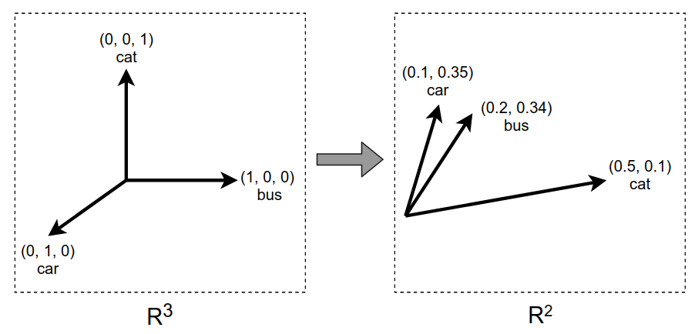
One-hot vs dense vectors
one-hot vectors:
words are equally distant in vector space
dense vectors (embeddings):
similar words have similar vectors
vs

Slide 43
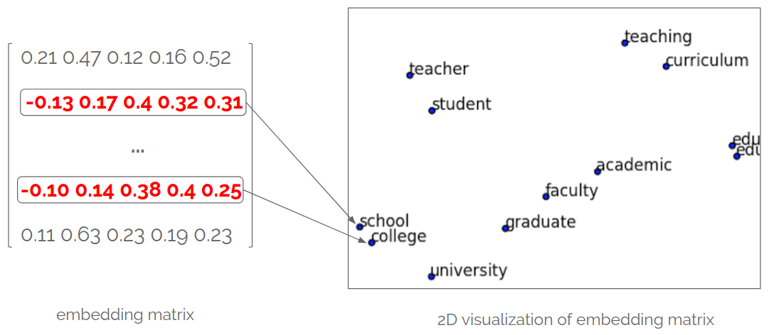
Visualizing word embeddings
number_of_words x 300

Slide 44
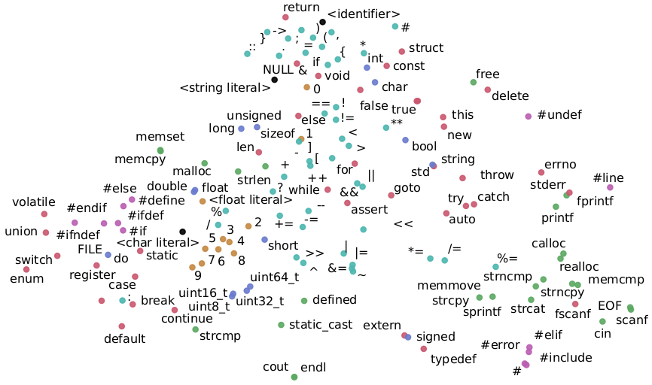
Visualizing embeddings for code tokens
‘words’ here are C/C++ code tokens
paper: Automated software vulnerability detection with machine learning, Harer et. al 2018

Slide 45
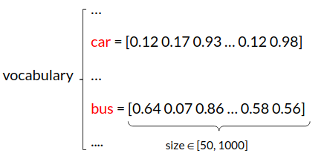
Having word vectors is nice, but how do we obtain them?

Slide 46
Having word vectors is nice, but how do we obtain them?
the word vectors are just parameters that the network will adjust during training

Slide 47
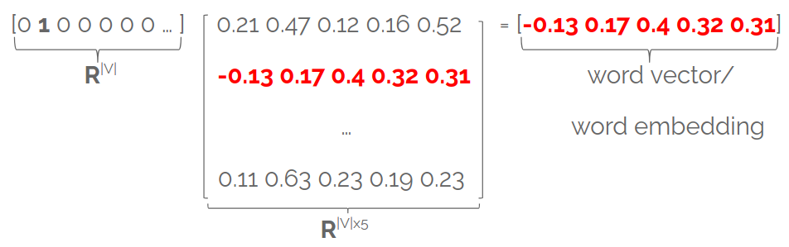
Embedding layer
stores word embeddings (one word per row) in a matrix E
E∈^{|V| x d} is the embedding matrix (learnable weights)

Slide 48
Embedding layer
stores word embeddings in a matrix E∈^{|V| x d}
each row in E is a word embedding associated with a given word
matrix E is fully learnable!
you can think of it as a fully-connected layer applied to one-hot vectors

Slide 49
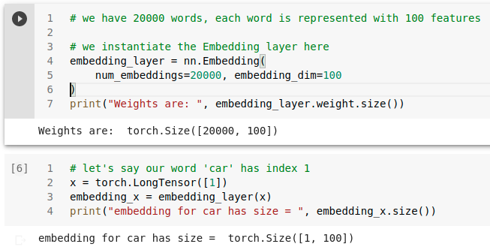
Embedding layer in PyTorch
we feed the indices of the words to the embedding layer

Slide 50
How do we get word embeddings?
by training a neural network on a particular task T
network will learn both:
how to represent words with features (embeddings)
how to solve the task T based on the embeddings (which are continually adjusted)

Slide 51

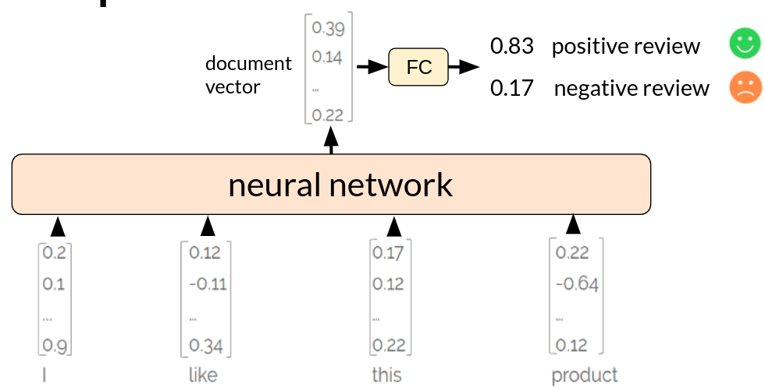
NN for text classification
Model learns both word embeddings and how to combine them for classification
neural network layers
word embedding layer
(randomly initialized)
students
...

Slide 52
NN for text classification
Model learns both word embeddings and how to combine them for classification
neural network layers
word embedding layer
(randomly initialized)
students
...
What if we don’t want to learn word features from scratch?

Slide 53
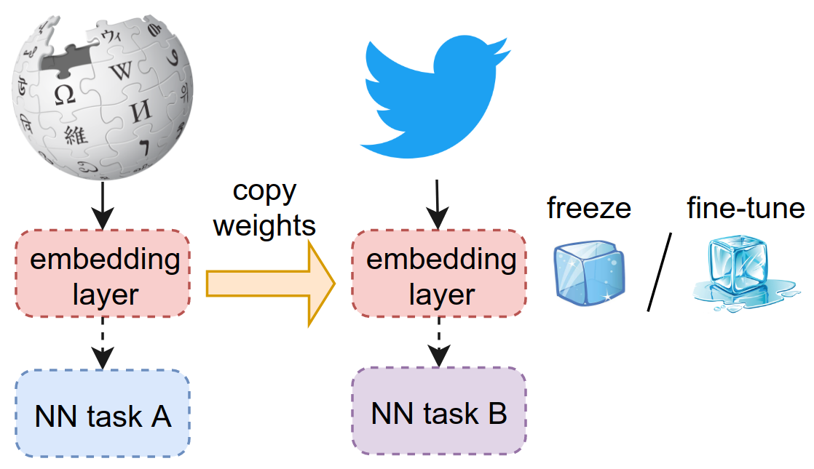
word2vec (Mikolov et al 2013)
Algorithm that learns general-purpose word vectors from lots of text
transfer learning: these word vectors can be used to initialize the embedding layer of another network

Slide 54
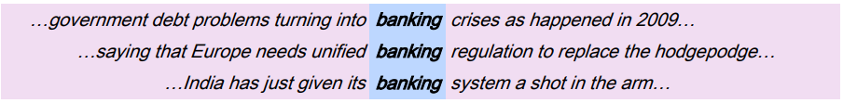
Find word based on its context
the same word is missing from each sentence
adapted from Stanford Deep Learning Course, Lecture 1 http://web.stanford.edu/class/cs224n/slides/cs224n-2019-lecture01-wordvecs1.pdf

Slide 55
Find word based on its context
the same word is missing from each sentence
given context, some words (banking, financial) are more likely than others
from Stanford Deep Learning Course, Lecture 1 http://web.stanford.edu/class/cs224n/slides/cs224n-2019-lecture01-wordvecs1.pdf

Slide 56
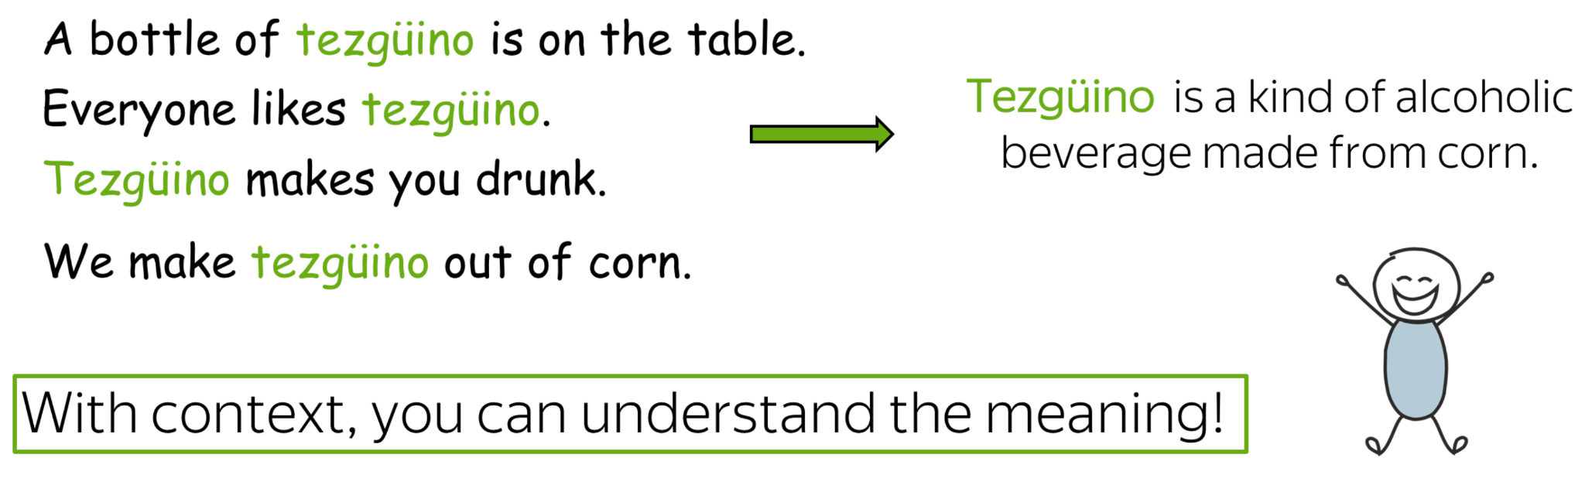
Distributional semantics
a word’s meaning is given by words that frequently appear nearby
‘You shall know a word by the company it keeps’ (Firth 1957)
source: https://lena-voita.github.io/nlp_course/word_embeddings.html

Slide 57
Meaning is context
a word’s meaning is given by the words nearby (context)
idea: use the many contexts in which ‘banking’ appears in order to build a word embedding for ‘banking’
from Stanford Deep Learning Course, Lecture 1 http://web.stanford.edu/class/cs224n/slides/cs224n-2019-lecture01-wordvecs1.pdf

Slide 58
word2vec (skip-gram negative sampling)
A simple classifier that learns word vectors from lots of text (Wikipedia)
Binary classification task: is word c a real context word for target word t?
drive many miles by car

Slide 59
word2vec (skip-gram negative sampling)
A simple classifier that learns word vectors from lots of text (Wikipedia)
Binary classification task: is word c a real context word for target word t?
drive many miles by car
Classifier predicts:
high probability for real (context, target) pairs:
P(context=real | c = drive, t = miles) = 0.86
P(context=real | c = car, t = miles) = 0.73
low probability for fake (context, target) pairs:
P(context=real | c = tomato, t = miles) = 0.13

Slide 60
word2vec training data (positive examples)
Running window over large quantities of text:
drive many miles by car
many miles by car to
miles by car to get
by bus to get to
bus to get to school

Slide 61
word2vec training data (negative examples)
Corrupt positive examples: replace context words with random words:
drive many miles by car
recipe

Slide 62
word2vec training data pairs
Positive (target, context) examples: Negative (target, context) examples:
miles drive miles recipe
miles many miles frontend
miles by miles fever
miles car miles lemon
… ...

Slide 63
How to compute probability?
two words t and c are similar if their word vectors have high dot product:
similarity(t, c) ≈ t·c
miles
drive
tomato

Slide 64
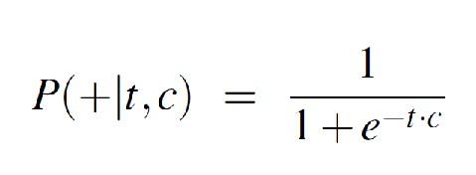
How to compute probability?
two words t and c are similar if their word vectors have high dot product:
similarity(t, c) ≈ t·c
probability that word c is the real context for target t:
miles
drive
tomato

Slide 65
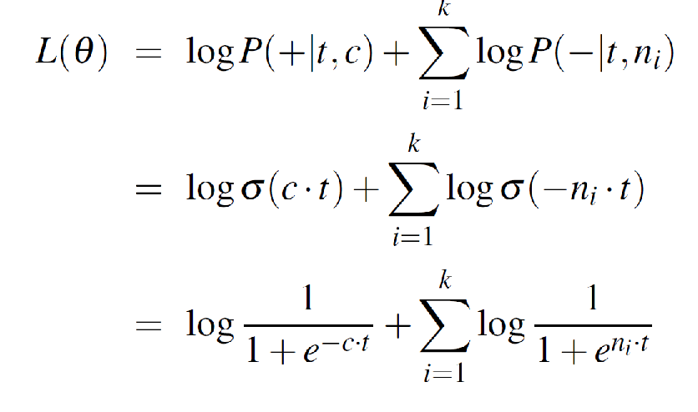
Learning objective
1 real (t, c) pair and k fake (t, n_{i}) pairs:
maximize these probabilities

Slide 66
Learning objective
1 real (t, c) pair and k fake (t, n_{i}) pairs:
maximize dot product between
target word t and real context word c

Slide 67
Learning objective
1 real (t, c) pair and k fake (t, n_{i}) pairs:
minimize dot product between
target word t and fake context word n_{i}

Slide 68
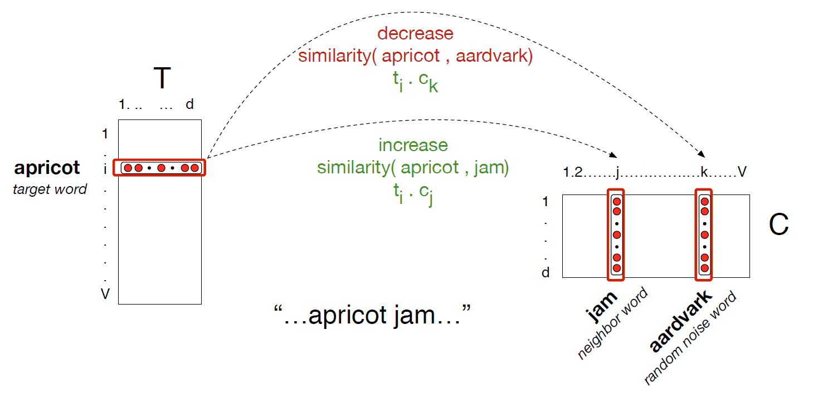
Shift embeddings during training
from Speech and Language Processing 3rd edition, Manning and Jurafsky

Slide 69
Word embeddings after training
number_of_words x 300

Slide 70
NN for text classification
Model ‘knows’ how to represent the words and only has to learn how to aggregate them into an output feature vector
neural network layers
word embedding layer
students
...
feature vector
initialized with pretrained word embeddings such as word2vec, Glove etc.

Slide 71
Transfer word embeddings
initialize word embedding layer with pretrained word embeddings (word2vec, GloVe, etc.)
either:
freeze word vectors on the new task B
fine-tune vectors on the new task B

Slide 72
Checkpoint 1
Tokenization
split text into smaller parts, called tokens
Word embeddings/word vectors
semantically-aware vectors (similar words have similar vectors)
Word2vec (negative sampling skip-gram)
algorithms that obtain general-purpose word embeddings
trains binary classifier to distinguish real (word, context) pairs from fake ones
vectors of similar words optimized to have high similarity
Transfer learning
initialize word embedding layer on a new task with pre-trained word embeddings: word2vec, Glove, fastText, etc.

Slide 73
Part 2: Sentences are vectors
this movie sucked
great cast, bad plot
…
best movie ever

Slide 74
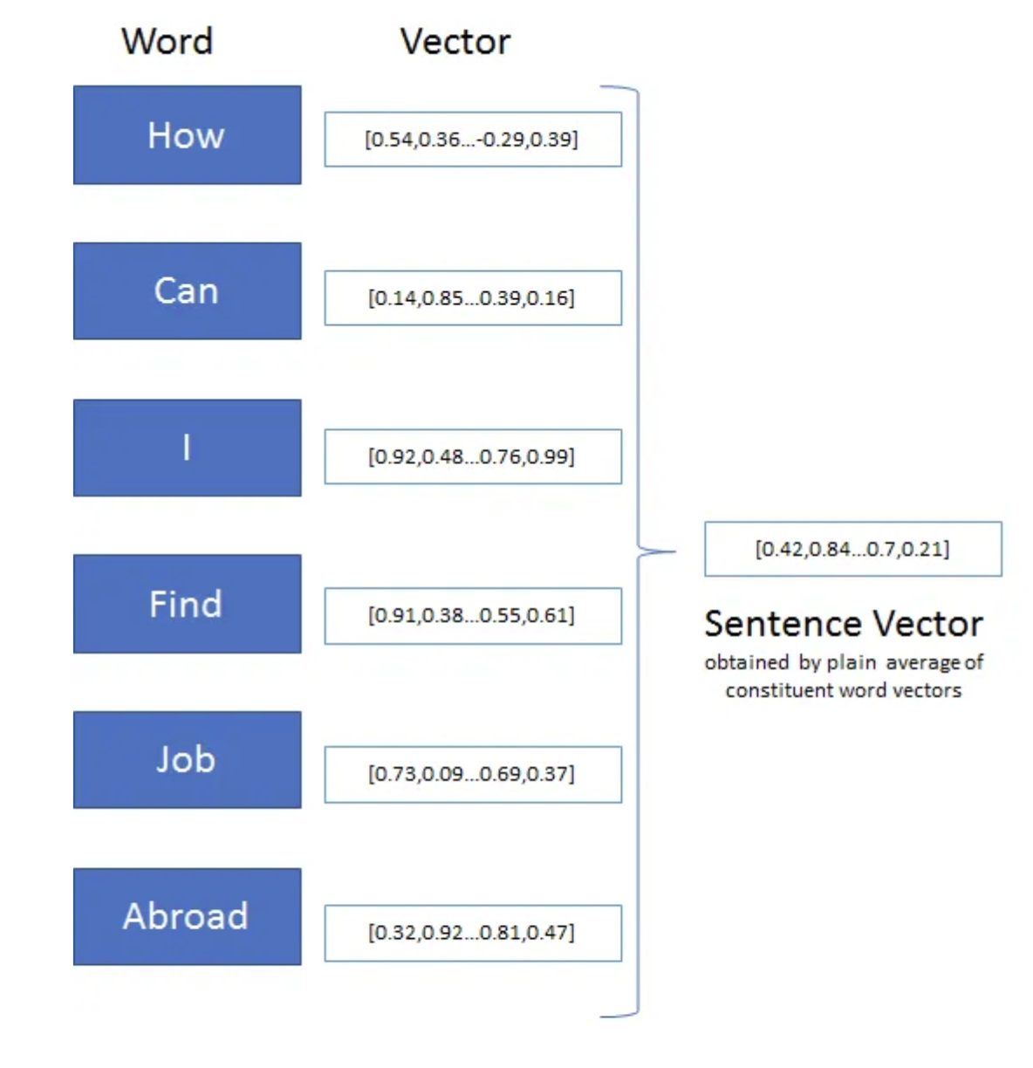
Sentence/document vectors
Steps:
represent sentences/documents as vectors:
v_{sentence} = f(v_{x1}, v_{x2}, … v_{xT})
similarity between sentences is similarity between their sentence vectors
Use cases: information retrieval, plagiarism detection, recommender systems

Slide 75


Apartment search
query Q
description D₁
description D₂
D₁
Q D₂
D₃ = ‘remote villa far away from civilisation’

Slide 76
NN for text classification
How does this network look like? Could we aggregate the word embeddings without a neural network?
neural network layers
word embedding layer
students
...

Slide 77
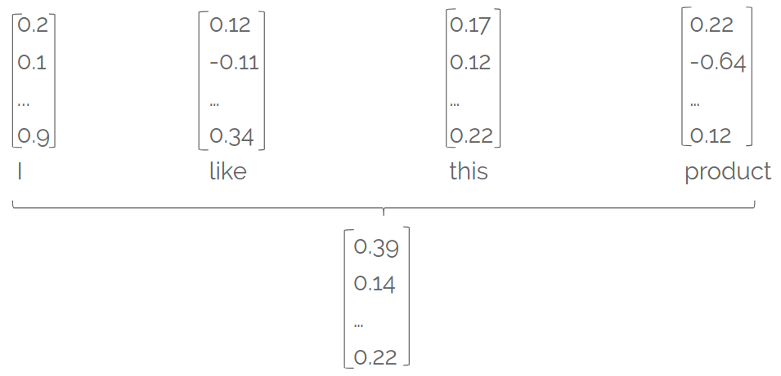
From word vectors to document vector
Goal: find vector representation for a sentence/paragraph/ document, starting from word vectors
document vector

Slide 78
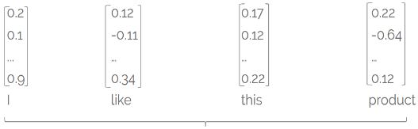
Bag of word embeddings
document vector = average/sum of word vectors
+
+
+

Slide 79
NN for text classification
Train MLP over bag of word embeddings
FC layers
word embedding layer
students
...
average/sum

Slide 80
Bag of word embeddings - drawbacks
document vector = average/sum of word vectors
+
+
+
however, order is discarded:
the movie wasn’t bad, it was actually quite good
the movie wasn’t good, it was actually quite bad

Slide 81
Bag of word embeddings - drawbacks
document vector = average/sum of word vectors
+
+
+
different meanings, same document vector
however, order is discarded:
the movie wasn’t bad, it was actually quite good
the movie wasn’t good, it was actually quite bad

Slide 82
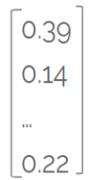


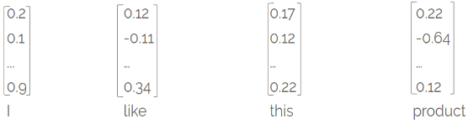
NN for text classification
0.83 positive review
0.17 negative review
we need a more complex model that:
aggregates word vectors
takes word order into consideration
document vector
FC
neural network

Slide 83

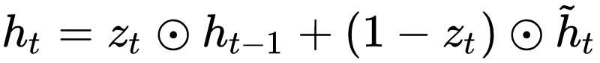
Visualizing RNN hidden states
each hidden state h_{t} aggregates info from:
current timestep x_{t}
the past (stored in the previous hidden state h_{t-1})
what is the value of z_{t} based on the diagram?
Unrolled RNN gif from https://towardsdatascience.com/illustrated-guide-to-recurrent-neural-networks-79e5eb8049c9

Slide 84
Visualizing hidden states
each hidden state h_{t} aggregates info from:
current timestep x_{t}
the past (stored in the previous hidden state h_{t-1})
what is the value of z_{t} based on the diagram?
z_{t} = [0.5 0.5 … 0.5]
Unrolled RNN gif from https://towardsdatascience.com/illustrated-guide-to-recurrent-neural-networks-79e5eb8049c9

Slide 85

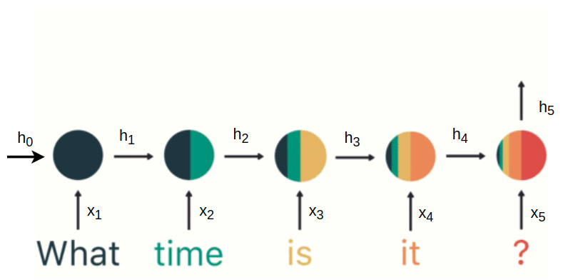
Visualizing hidden states
Final hidden state h₅
aggregates information from the whole sequence
takes order into consideration
source

Slide 86
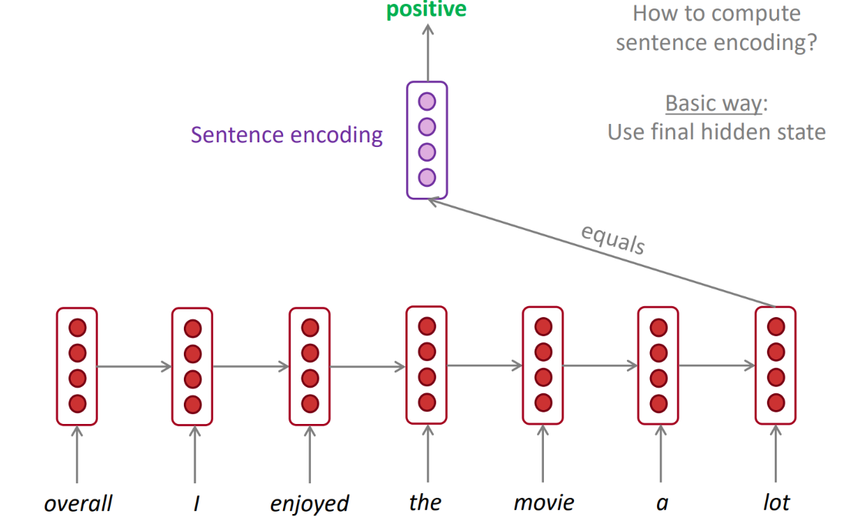
Last hidden state as sentence embedding
Training:
compute last hidden state using RNN => h_{t}
apply fully-connected layer to h_{t} (+softmax) to get class probabilities:
p = softmax(Wh_{t}+b)
cross-entropy loss
0.73 positive sentiment
0.27 negative sentiment
FC
h₇
h₁
h₂
h₃
h₄
h₅
h₆
source: Stanford CS224, lecture 6

Slide 87

Last hidden state problem
last hidden state h₅ is biased towards information from the end of the sequence
information from the beginning of the sequence more likely to ‘wash away’ (even with good gradients)
source

Slide 88
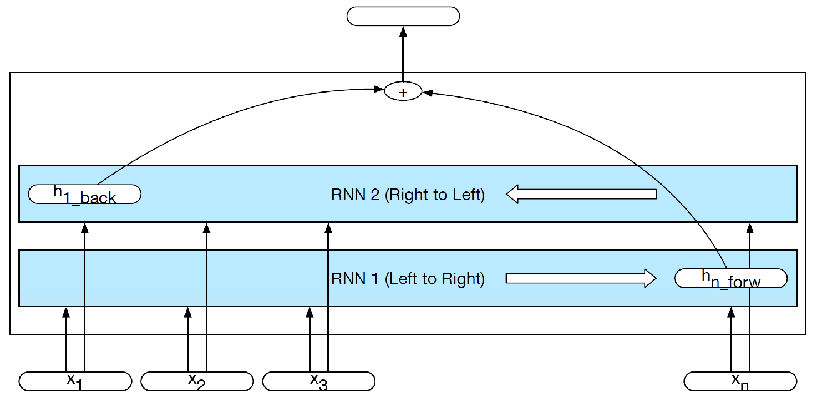
Bidirectional LSTMs
train separate left->right and right->left LSTMs
process both final hidden states (concatenate/add) to make prediction
information from the beginning of the sequence more easily integrated
document embedding
0.73
0.27
FC
from Speech and Language Processing 3rd edition, Manning and Jurafsky

Slide 89
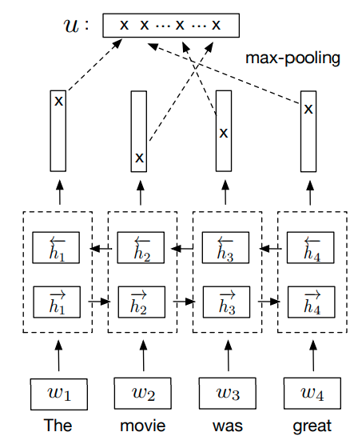
Bidirectional LSTMs with maxpooling
document embedding
0.73
0.27
train separate left->right and right->left LSTMs
concatenate hidden states from both directions at each timestep
apply max-pooling over time to select most salient neuron at each timestep
superior results over other sentence encoders (Conneau et al. 2018)
FC
source
Notes:
https://pratyushmaini.github.io/Pooling-Analysis/ https://arxiv.org/pdf/2005.00159.pdf
pooling helps with vanishing gradient and reduces positional bias

Slide 90
NN for text classification
0.83 positive review
0.17 negative review
can we think of another type of network to process input sequence?
document vector
FC
neural network

Slide 91
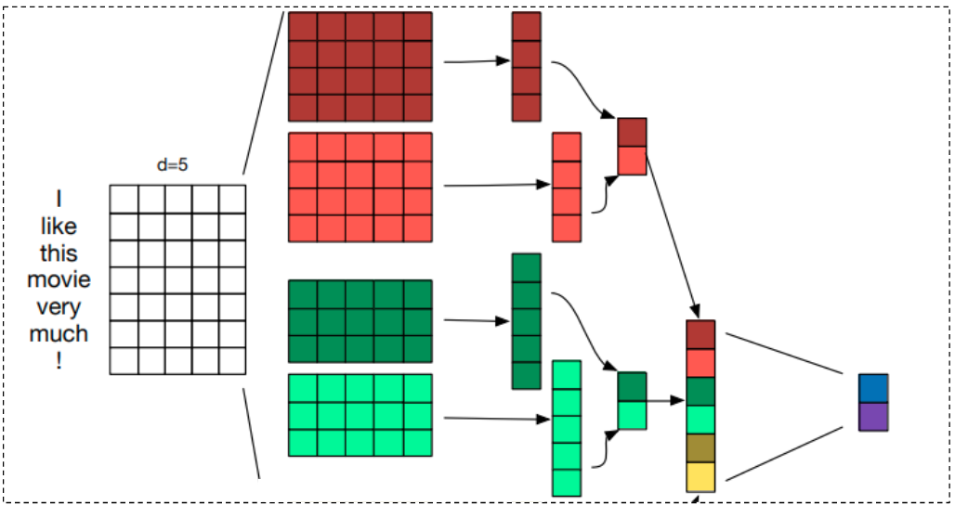
CNN sequence encoder
key operations:
1D convolution filters (different kernel sizes to capture n-grams of varying length)
max pooling over time
adapted from A Sensitivity Analysis of (and Practitioners’ Guide to) Convolutional Neural Networks for Sentence Classification
Notes:
CNN vs RNN https://arxiv.org/pdf/1702.01923.pdf

Slide 92
RNN vs CNN as text encoders
Pros: can extract long-range dependencies He said that no matter what happens, they will get full support from him | Pros: good at extracting local and position invariant features (certain phrases) I really liked this movie, it was very good, despite all the flaws in writing.
Cons: biased towards more recent elements | Cons: max-pooling over time discards order finicky to train

Slide 93
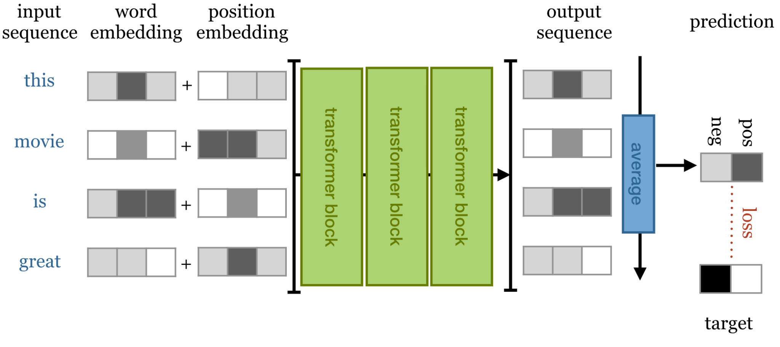
Transformer as sequence encoder
key operations:
each output vector o_{t} has information from all input words
sentence vector = avg(output vectors) or maxpool(output vectors)
source:https://peterbloem.nl/blog/transformers

Slide 94
Checkpoint 2 - text classification starting from word embeddings
Simple baseline = MLP over bag of word embeddings
however, averaging/summing word vectors discards temporal order
use RNNs to aggregate word embeddings sequentially
use last hidden state to classify
train bidirectional LSTMs and use last hidden states in each direction to account for beginning and end of sentence
train bidirectional LSTM+maxpooling to reduce positional bias
use 1D CNN with maxpooling
can capture n-grams that are informative regardless of their position
use Transformer to combine word embeddings

Slide 95
Word embeddings drawbacks
Sensitive to small differences: apple vs apples
Cannot represent out-of-vocabulary words (fantastik)
but can be enriched with subword information (character n-grams) (Bojanowski et. al 2017)
Encode biases found in text:
sim(black, criminal) > sim(white, criminal)
sim(man, doctor) and sim(woman, nurse) high
Cannot handle polysemy (go home vs let’s play go):
this is why they are also called static embeddings or context-free embeddings

Slide 96

Part 3: Better word embeddings

Slide 97
NN for classification from word embeddings
‘play’ can be a verb or a noun depending on its context, however it is mapped to the same vector
model has to:
learn to disambiguate ‘play’/’like’ etc
aggregate features into a document vector
0.83 positive review
0.17 negative review
document vector
FC
neural network
play

Slide 98





Transfer deep features in CV vs NLP
...
high level features
we’d like to learn these features as well during pretraining
opened .
books.
students.
contextual word embeddings
mid level features
their .
opened .
books .
low level features
students .
word embeddings
their .
students opened their books

Slide 99

Word embedding types
context-free/static: each word x_{i} has a single embedding v_{i}, regardless of the word’s context
contextual: word x_{i} embedding depends on the word’s context:
h_{i} =f_{θ}(v_{i}, context)

Slide 100



Recipe for contextual word embeddings
architectures
self-supervised tasks
lots of data
Predict future from past:
I wonder what to say ____
Fill-in-the-blank:
I feel like ____ is missing
based on recurrent networks (ELMo)
based on Transformer (BERT)

Slide 101
RNN hidden states as contextual embeddings
each hidden state h_{t} can be seen as:
contextual word embedding of x_{t} (embedding of x_{t} that takes into account its left context x₁, x₂, …, x_{t-1})
source

Slide 102

RNN hidden states as contextual embeddings
hidden state h₃
contextual word embedding of ‘is’ (made from the static word embedding of ‘is’ and its left context ‘What time’)
source

Slide 103
RNN hidden states as contextual embeddings
contextual word embeddings:
h₁- contextual embedding of ‘What’
h₂- emb. of ‘time’ (that knows about ‘What’)
h₃- emb. of ‘is’ (that knows about ‘What’ and ‘time’ )
h₄- emb. of ‘it’ (that knows about ‘What’, ‘time’ and ‘is’ )
h₅- emb. of ‘?’(that knows about ‘What’, ‘time’, ‘is’ and ‘it’)
source

Slide 104

Bidirectional contextual word embeddings
combine hidden states from left-to-right and right-to-left deep RNNs at several depths
figure from http://jalammar.github.io/illustrated-bert/

Slide 105

Contextual word embeddings from Transformer
each output vector y^{(i)} incorporates context from all input vectors x⁽¹⁾, x⁽²⁾, …, x^{(N)}
knows about ‘The’, ‘Broadway’, ‘premiered’ and ‘yesterday’
contextual word embeddings
word embeddings

Slide 106

ELMo (Peters et. al 2018)
mix bidirectional hidden states from all depths
lower level hidden states capture syntax, while higher level hidden states capture semantic aspects
plug ELMo vectors in the target task model and fine-tune ƛ coefficients
figure from Transfer Learning in Natural Language Processing, by Sebastian Ruder

Slide 107
Transfer deep features in CV vs NLP
...
contextual word embeddings
high level features
learn hierarchical features using stacked Transformers or RNNs
opened .
books.
students.
contextual word embeddings
mid level features
their .
opened .
books .
low level features
students .
word embeddings
their .
students opened their books

Slide 108

Deep transfer learning in NLP
transfer pre-trained deep models, which:
are based on the Transformer block
are trained with self-supervised tasks
encode deep contextual embeddings
fine-tuning these models for each specific task leads to large performance improvements
depth = 24 blocks

Slide 109


Word embeddings taxonomy
type
model
context
task
Notes:
Recurrent-based contextual representations work well, but can we do without RNNs?

Slide 110

BERT (Bidirectional Encoder Representations from Transformers)
network produces deep contextual word embeddings using 24 stacked Transformer blocks
fine-tuning BERT results in state-of-the-art on 11 NLP tasks

Slide 111

Pretrain-finetune paradigm
pre-train model on large data (Wikipedia - 2.5B words + BookCorpus - 800M words)
fine-tune separate models for each classification task

Slide 112

BERT training task 1
Masked Language Modeling (MLM): mask 15% of input words and then predict them
output vectors T_{i} incorporate bidirectional context
...
...
T₁
T₂
T₅
T₅₁₂
BERT
figure from http://jalammar.github.io/illustrated-bert/
Notes:
BERT naturally incorporates bidirectional context, via the MLM task and bidirectionality of self-attention.

Slide 113

BERT training task 2
Next sentence prediction (NSP): given two sentences A and B, does B follow A?
subsequent papers (RoBERTa - Facebook) showed NSP objective can be removed
figure from http://web.stanford.edu/class/cs224n/slides/Jacob_Devlin_BERT.pdf

Slide 114

Input representation
add token, segment and position embeddings
special tokens:
[CLS] beginning of sequence

Slide 115
Input representation
add token, segment and position embeddings
special tokens:
[CLS] beginning of sequence
[SEP] separates two sentences/segments

Slide 116

Visualizing and Measuring the Geometry of BERT (Coenen et. al 2019)
contextual word embeddings for ‘die’ (in different contexts)

Slide 117

BERT for text classification
[CLS] token is ‘neutral’
h_{[CLS]} is obtained from [CLS] ‘attending’ to all the other tokens
h_{[CLS]} can be used for sentence-level classification
h₁, h₂, … h_{N} used for token-level classification (named entity recognition)

Slide 118


Transfer shallow features vs deep features
train these weights
target task model
target task model
transfer
shallow features:
word embeddings
Transformer block
transfer deep features:
word embeddings + contextualized word embeddings
Transformer block

Slide 119

Paradigm shift
finetune era: lots of architecture engineering on top of shallow features
pretrain-finetune era: focus on better pretraining, loss functions etc.

Slide 120
Part 4: Language Models or learning what to say next

Slide 121

Word embeddings taxonomy
type
model
context
task

Slide 122


Language Model
task: predict the next word, given the previous ones
reverse task: predict past from future

Slide 123


Language Model
objective: learn probability distribution over sequence of tokens

Slide 124

Language Models applications
generate text token by token
compute probability of sentence
P(caption| ) ∝ P( |caption)P(caption)
P(recognize speech) = 0.6
P(wreck a nice beach) = 0.05

Slide 125


Neural Language Model
Input Output
∅ P(x₁)
x₁ P(x₂|x₁)
x₁, x₂ P(x₃|x₁, x₂)
… ...
x₁, x₂, … x_{t} P(x_{t+1}|x₁, x₂, …, x_{t})
Ingredients:
variable-length feature extractor:
predictor:
f is an neural network

Slide 126


Recurrent language model
t=4:
input: the, students, opened, their
output: probability distribution over all words in the vocabulary
label: laptops
loss: -log P(laptops|...)

Slide 127

Recurrent language model training
total loss: -log likelihood of correct word over all timesteps:
students
...
...
...

Slide 128
Recurrent language model recap
use RNN to encode words
at train time, predict next word x^{t+1} from each hidden state h_{t}
at test time, sample a word at each time step and feed it back to the model
students
...
...
...

Slide 129

GPT: Transformer language model (2018)
same objective as RNN LM, but encode input using masked self-attention (each word can only ‘attend’ to previous words)
showed that Transformer LM are an effective pretraining technique for downstream tasks
orders
source: https://jalammar.github.io/illustrated-gpt2/

Slide 130

Neural LM generalizes to unseen sequences
P(llama | chases, a) ≠ 0
even if ‘chases a llama’ was never in the training set. Why?
target words (‘llama’, ‘cat’, ‘mouse’) tend to appear in similar contexts, so their representations are also similar
mouse
llama

Slide 131
Part 5: Large Language Models or how I wanted to say what’s next and accidentally solved everything

Slide 132

Scaling Language Models
Trends:
larger models (up to 1T B )
models trained on increasingly more data (trillion tokens)
source

Slide 133

What does the LM task learn under the hood?
source: Stanford CS224N https://web.stanford.edu/class/cs224n/slides/cs224n-2023-lecture11-prompting-rlhf.pdf

Slide 134

Emergence of in-context learning
training with the LM objective makes the model learn general-purpose semantic features, which transfer well
however, when scaling them up, the models also start to exhibit an ability to solve tasks with no/a few examples and without gradient updates
1-shot example fromhttps://arxiv.org/pdf/2206.07682.pdf

Slide 135

In-context learning (GPT3 - 2020)

Slide 136

GPT3
performance increases with:
more examples shown in context
larger models
finetuned task-specific models can outperform LLMs, but they still require training examples and gradient updates
Large Language Models (LLM) however are general-purpose task solvers

Slide 137

LLMs generate falsehoods
source: TruthfulQA

Slide 138

LLM outputs are not helpful
LLMs are trained to predict next token
outputs don’t necessarily align with human intention
source: TruthfulQA

Slide 139

LLMs as human assistants
How do we get from:
Einstein was born in ________
to this:

Slide 140

Instruction Tuning
start from pretrained LLM
teach LLM to follow instructions: finetune it on (request, completion) instructions
source: Scaling Instruction-Finetuned Language Models

Slide 141

Preference optimization
start from instruction-tuned LLM
teach LLM to prefer one output over the others
preference data: tuples (input request, preferred completion, other completions)
source: https://arxiv.org/pdf/2305.18290.pdf

Slide 142

LLM steps
aka instruction tuning
Pretraining
train with (request, completion) examples
/ Base model

Slide 143

InstructGPT (based on GPT3.5)
finetune LLM on human collected instructions
use human feedback to learn a reward model to rank LLM outputs
use RL to align LLM to human preferences, by using the signal from the reward model
source: InstructGPT

Slide 144

InstructGPT (based on GPT3.5)
source: https://openai.com/research/instruction-following

Slide 145

chatGPT = InstructGPT + dialogue instructions

Slide 146

Prompt Engineering
Search for the best input that ‘triggers’ your LLM to solve the task

Slide 147

Is finetuning dead?

Slide 148
Prompt Engineering
easier to set up than fine-tuning
iterate through many prompt formats to get it right
prompting closed models (GPT4) can lead to inconsistent results across time
inference is costlier than smaller finetuned models
LLM may know how to perform task, but lack the knowledge:
use LLM to analyze company data
use GPT4 to understand Spring 2024 events
may underperform in some areas (code understanding), domain specific tasks (summarizing legal documents), or non-English languages (Romanian)

Slide 149

Retrieval Augmented Generation
premise: model knows what the question refers to, but lacks appropriate context
solution: separate SEARCH and GENERATION
SEARCH: find appropriate context C
GENERATION: augment question Q with C and feed [Q;C] to model

Slide 150
Finetune vs RAG
if you need more context/factuality => RAG
incorporates external knowledge but may not customize model’s behavior/style
if you need the model to act in a specific way => finetune
continual pretraining:
can teach model deeper understanding of a particular domain
supervised finetuning/instruction tuning:
can constrain the model to have a specific tone/style or output format
the approaches are complementary

Slide 151
NLP paradigms
[2013-2017] architecture engineering:
use static word embeddings as a starting point
train task-specific models on top of these shallow features
[2018-now] pretrain-finetune:
pretrain a LM/MLM to learn deep contextual word embeddings
add task-specific layers to this backbone and finetune separate models for each task
[2020-now] Large Language Models:
train a large language model
use it as a general-purpose language task solver, which performs tasks in zero-shot/few-shot setting

Slide 152
TODAY
word embeddings:
vectors that capture the ‘meaning’ of words
vectors of similar words have high similarity
contextual word embeddings:
‘dynamic’ word vectors that change depending on the context
learned using RNN/Transformers with self-supervised tasks (e.g., masked language model)
large language models:
general-purpose language solvers that ‘implicitly’ learn to solve tasks

Slide 153
Thank you!
(Next: Unsupervised learning)

Slide 154
Resources for NLP with NNs
Textbooks:
A Primer on Neural Network Models for Natural Language Processing, Yoav Goldberg
Natural Language Understanding with Distributed Representation, Kyunghyun Cho
Speech and Language Processing 3rd edition, Dan Jurafsky and James H. Martin
Courses:
Stanford Deep Learning for NLP: http://web.stanford.edu/class/cs224n/
CMU Neural Networks for NLP: http://www.phontron.com/class/nn4nlp2020/

Slide 155
References
Word embedding papers:
Efficient Estimation of Word Representations in Vector Space, Mikolov et. al 2013
Contextual word embeddings papers:
ELMo: Deep contextualized word representations, Peters et al. 2018
Transformer: Attention is all you need, Vaswani et al. 2017
GPT: Improving Language Understanding by Generative Pre-Training, Radford et al. 2018
BERT: Pre-training of Deep Bidirectional Transformers for Language Understanding, Devlin et al. 2018
Large Language Models papers:
GPT3:
InstructGPT: https://arxiv.org/pdf/2203.02155.pdf
Survey: https://arxiv.org/pdf/2303.18223.pdf

Slide 156
References (2)
Presentations:
Deep Learning Meetup March 2020: slides
Blogs:
https://jalammar.github.io/illustrated-transformer/
https://jalammar.github.io/illustrated-bert/
https://ruder.io/nlp-imagenet/

Slide 157

Language Models in action
Predictive typing Text generation
“The Malfoys!” said Hermione.
Harry was watching him. He looked like Madame Maxime. When she strode up the wrong staircase to visit himself.
Picture from https://www.pressstart.co.uk/blog/predictive-typing-tips
Text from https://medium.com/deep-writing/harry-potter-
written-by-artificial-intelligence-8a9431803da6

Slide 158



RNNLM inputs and labels
Inputs:
Ground truth labels:
S
NMT tutorial ACL 2016, Luong, Cho and Manning

Slide 159
char-RNNLM feedforward
output distribution:
Ŷ^{(t)} = P(x^{(t+1)}|x⁽¹⁾, x⁽²⁾, …, x^{(t)})
= softmax(Uh^{(t)}+b) ∈ R^{|Vocabulary|}
hidden state:
h^{(t)} = RNN(e^{(t)}, h^{(t-1)}) ∈ R⁵¹²
character embedding:
e^{(t)} ∈ R¹²⁸
character input:
x^{(t)}∈ {0, 1, 2, 3, …, |V|-1}, V is vocabulary
b
h
d
...
...
c
a
...
t
h

Slide 160


RNNLM training (2)
Expensive to compute losses over all corpus and backpropagate
In practice, losses computed over a mini-batch of sequences (16/32/64)

Slide 161
RNNLM training (2)
Expensive to compute losses over all corpus and backpropagate
In practice, losses computed over a mini-batch of sequences (16/32/64)
first iteration, batch = 4

Slide 162
RNNLM training (2)
Expensive to compute losses over all corpus and backpropagate
In practice, losses computed over a mini-batch of sequences (16/32/64)
second iteration, batch = 4

